Slide 1
CAPSTONE PROJECT
RESTAURANT MANAGEMENT SYSTEM
Presented By:
1.VARNIKHA SRI TS-2021311037
B.TECH PETROLEUM ENGINEERING AND TECHNOLOGY
ACTECH-ANNA UNIVERSITY

Slide 2
OUTLINE
Problem Statement
Proposed System/Solution
System Development Approach
Algorithm & Deployment
Result
Conclusion
Future Scope
References

Slide 3
PROBLEM STATEMENT
The billing process is done manually by manpower. It results in delayed time for the consumer and to the organization while the bill is being processed. So, there is a room for improvement here. A certain computer-based billing system could aid the organization to utilize its resources better. Computerized Billing System provide capabilities for entering client, employee and payment information, building a record and managing other related data needs in the organization. The currently used system contains the following problems which are listed be-low:
Inability of modification of data
Manual operator control
Lots of paperwork
Difficult to retrieve information on time
Difficult to record information systematically
Wastage of paper

Slide 4
PROPOSED SOLUTION
Restaurant Management System is a computer based billing system with user friendly interface which automatically manages the billing process of the customer very easily taking only a short period of time. The system can large amount of data and also generates bill for the customer. Billing history, reservation information and staff information can also be obtained with the use of RMS.It is an automated desktop based software which has a simple design and very easy to use also. This project's main focus is on proper management of information regarding the staffs, billing and reservation records. It is also specialized in automatically processing the customer bills and discounts. The proposed system either does not require paperwork or very few paper works are required. All the data is fetched into the computer immediately and various bills can be generated through computers. Since all the data is kept in a database, no data of the organization can be destroyed. Moreover works become very easy because there is no need to keep data on papers.

Slide 5
SYSTEM APPROACH
A system approach to designing a restaurant management system in Python involves breaking down the system into smaller, manageable components or modules, each responsible for a specific aspect of the restaurant's operations. Here's a high-level outline of how you can approach this:
Identify Requirements: Understand the requirements of the restaurant management system. This includes functionalities such as managing menus, processing orders, handling reservations, managing inventory, and generating reports.
Modular Design: Divide the system into modules based on functionalities. Common modules may include:
Menu Management
Order Processing
Reservation Management
Inventory Management
Reporting
Define Classes: For each module, define classes that represent the entities and actions within that module. For example:
Menu class for managing menu items
Order class for processing customer orders
Reservation class for handling table reservations
Inventory class for managing stock levels

Slide 6
4. Establish Relationships: Define relationships between the classes/modules where necessary. For example, an order may consist of items from the menu, and inventory levels may be affected by orders placed. 5. Implement Functionality: Implement the methods and functions within each class/module to perform the desired functionalities. This may involve tasks like adding/removing items from the menu, placing orders, updating inventory levels, and managing reservations. 6. User Interface (Optional): Depending on your requirements, you may create a user interface for interacting with the system. This could be a command-line interface, a graphical user interface (GUI) using libraries like Tkinter or PyQt, or a web-based interface using frameworks like Flask or Django. 7. Testing and Refinement: Test the system thoroughly to ensure that it works as expected and meets the requirements. Refine the system based on feedback and testing results. 8. Documentation: Document the system including its design, functionalities, and usage instructions. This will help in understanding and maintaining the system in the future.

Slide 7
ALGORITHM & DEPLOYMENT
Algorithm for Restaurant Management System:
Menu Management:
Define a class for Menu Item with attributes like name, price, and description.
Create a Menu class to manage the menu items.
Implement methods to add, remove, and display menu items.
Order Processing:
Define a class for Order with attributes like order_id, items, total_price, etc.
Create methods to add items to the order, calculate the total price, and process the order.
Reservation Management:
Define a class for Reservation with attributes like reservation_id, customer_name, date_time, table_number, etc.
Implement methods to make a reservation, check availability, cancel a reservation, etc.
Inventory Management:
Define a class for Inventory with attributes like item_name, quantity, price, etc.
Create methods to manage inventory items such as adding stock, updating quantities, and generating alerts for low stock.
Reporting:
Implement functionality to generate various reports such as sales report, inventory report, etc., based on user requirements.

Slide 8
User Interface: Depending on your deployment choice (discussed later), design a user interface for interacting with the system. This could be a command-line interface, a web-based interface, or a GUI. Deployment Options: Local Deployment: Run the Python program on a local machine. Users can interact with the system through the command line or a graphical user interface if developed. Package the application using tools like PyInstaller to create standalone executables for easy distribution. Web-Based Deployment: Develop a web application using frameworks like Flask or Django. Host the web application on a server (locally or on a cloud platform like Heroku, AWS, or Google Cloud Platform). Users can access the restaurant management system through a web browser from anywhere with an internet connection. Mobile App Deployment: Develop a mobile application using frameworks like Kivy or React Native. Deploy the mobile app to app stores like Google Play Store or Apple App Store. Users can download and install the app on their mobile devices to access the restaurant management system. Containerization: Containerize the application using Docker for easy deployment and scalability. Deploy the Docker containers to container orchestration platforms like Kubernetes. Hybrid Deployment: Combine multiple deployment options based on your requirements. For example, you can have a web-based system for online orders and reservations, along with a local system for in-house operations.

Slide 9
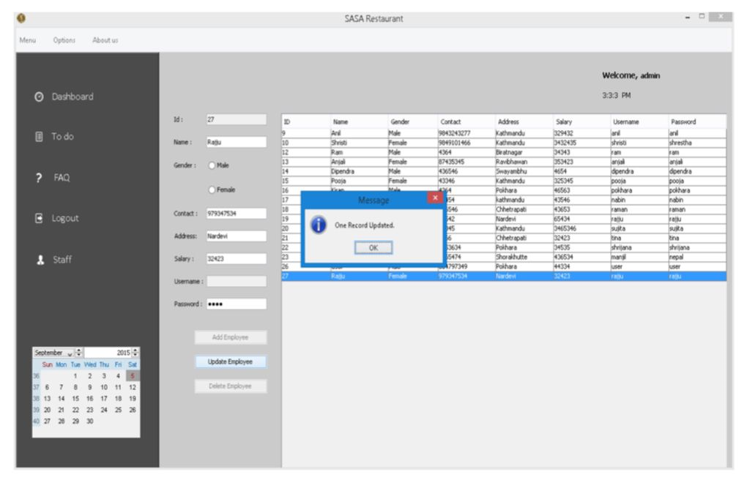
RESULT
Commenting on the result obtained by Restaurant Billing System, the system is able to add the information of the staff, make reservation for the customer, billing, etc. Interpreting the result, the staff information can be added, edited, updated and deleted. Reservation can be made and cancelled and the bill can be printed. The outputs obtained by the system are shown in the figure below:
Updating customer information

Slide 10
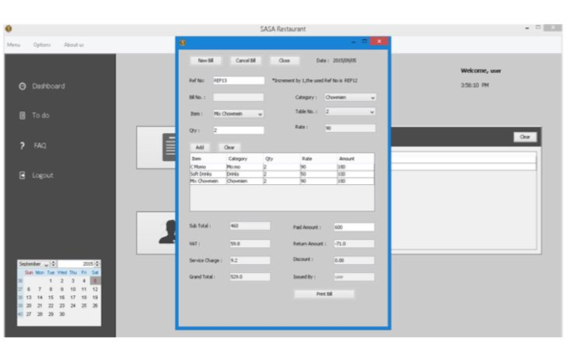
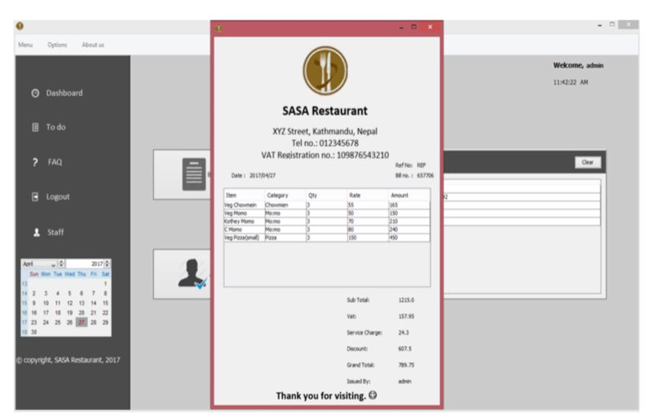
Billing Output
Billing Print Output

Slide 11
CONCLUSION
The documentation includes all necessary information on the structure and the coding of the program created for Restaurant Management system. Creating the program was an overwhelming task that required a lot of analyzing, research work and personal skills. Creating this report has been a great experience and numerous facts have been learned since the required tasks were very challenging. Tasks such as creating a system to a restaurant, needed research work as well as personal skills. Creating proper design and smooth flow of operation was a very tiring task that consumed a lot of time. The program has been created successfully with proper design and working flow of operation. The billing part was the most important and difficult part of this project. Retrieving data from database for the billing purpose was quite a tough task. Making changes on multiple data base using SQL queries was also a bit time consuming and though provoking task. In conclusion, many experiences have been gained specially in coding. Time management and teamwork is very important in the development system.

Slide 12
FUTURE SCOPE
RMS software offers various functionalities needed to effectively manage restaurant operations such as staff management, making orders, billing, menu management, reservation, viewing order history, to-do list and many more. In the future, many enhancements/upgrades can be made to the existing software. Various enhancements such as inventory management and control, wireless table side ordering and payment, real-time alerts, online ordering, mobile management capabilities can help increase revenue and cut cost.

Slide 13
REFERENCES
Restaurant Billing System: https://www.scribd.com/doc/283903672/Online-Ordering-System-
Project Objective :https://www.scribd.com/document/36253350/04-Project-Billing- System
Scopes and Limitation: https://kungfumas.files.wordpress.com/2017/09/099.pdf
Feasibility study: http://www.slideshare.net/alok104/synopsis-on-billing-system-27487568
UML Diagram : https://www.techopedia.com/definition/3243/unified-modeling-language-uml/
Use Case Diagram: http://whatis.techtarget.com/definition/use-case-diagram
Class Diagram: http://searchmicroservices.techtarget.com/definition/class-diagram
Sequence Diagram : https://creately.com/blog/diagrams/sequence-diagram-tutorial/
ER Diagram: http://searchcrm.techtarget.com/definition/entity-relationship-diagram
Interfaces : https://www.youtube.com/watch?v=9K5sS7j5wWI

Slide 14
THANK YOU

